Slide 1
Integration Training
Process Development
TSC
.
Customer & Enterprise Integration
Nanjing, Jan. 2021

Slide 2
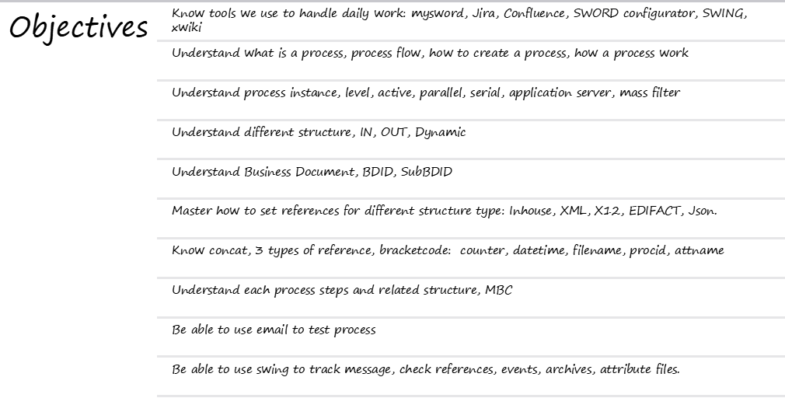
Process Development
Schenker China Ltd.

Slide 3
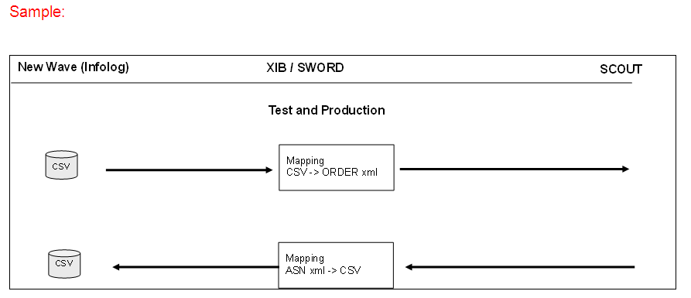
Process Development
Sword Integration Flow
use communication protocol/rule to detect
fetch references, create BDIDs
add MBCs to process file
specify routing code to send out data
Detection
Processing
Routing

Slide 4
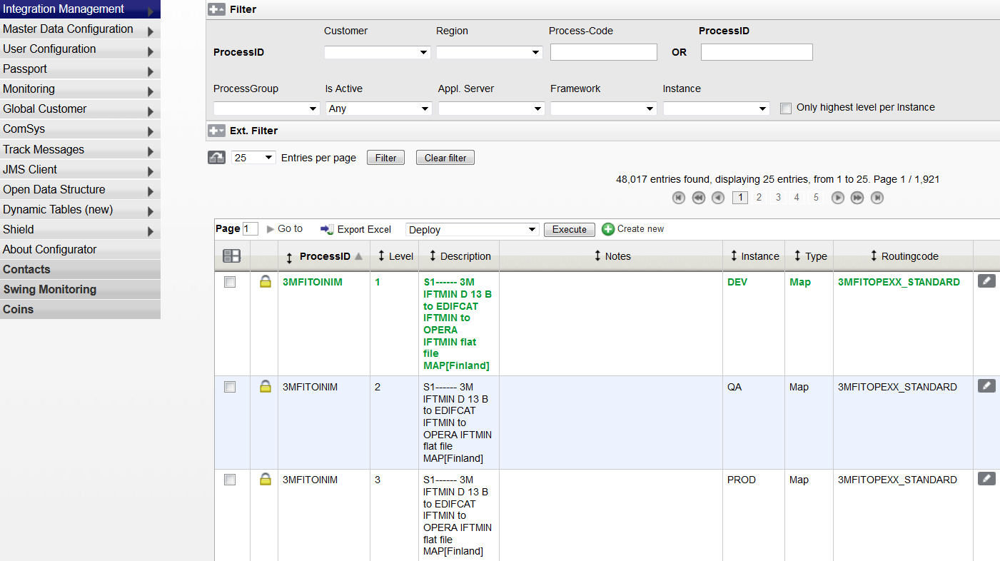
Process Development
Create a New Process
  Process ID: Customer (4 digit) + Region (1 digit) + Process-Code (5 digit)
click to create
a new process
3 instances:
DEV
QA
PROD

Slide 5
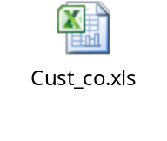
Process ID Naming Convention
Process ID is consist of 10 characters
  Customer Code: first 4 characters (e.g. SIEM = Siemens, APPL = Apple)
  Region Code: 5th character
    E – Corporate (EMEA)
    C – Canada
    U – USA
    A – Asia Pacific
    T – Region East (Poland, Finland)
  Free form: 6th to 8th characters of your choice to specify the Process (can be the output format of the file)
  Incoming File Type: 9th to 10th characters (e.g. AN = ANSI, XM = XML)

Slide 6
Process Development
  Level Concept:
DEV
QA
PROD
TESTE2ANCE 2 QA
TESTE2ANCE 5 QA
TESTE2ANCE 3 PROD
TESTE2ANCE 6 PROD
TESTE2ANCE 1 DEV
TESTE2ANCE 2 QA
TESTE2ANCE 3 PROD
TESTE2ANCE 4 DEV
TESTE2ANCE 5 QA
TESTE2ANCE 6 PROD
Process ID Level Instance
Process ID Level Instance
Process ID Level Instance
1. Create a new process
2. Copy to QA instance
3. Deploy to QA system
5. Copy to PROD instance
6. Deploy to PROD system
8. Change this process
……
4. Test in QA system
7. Go live in PROD system

Slide 7
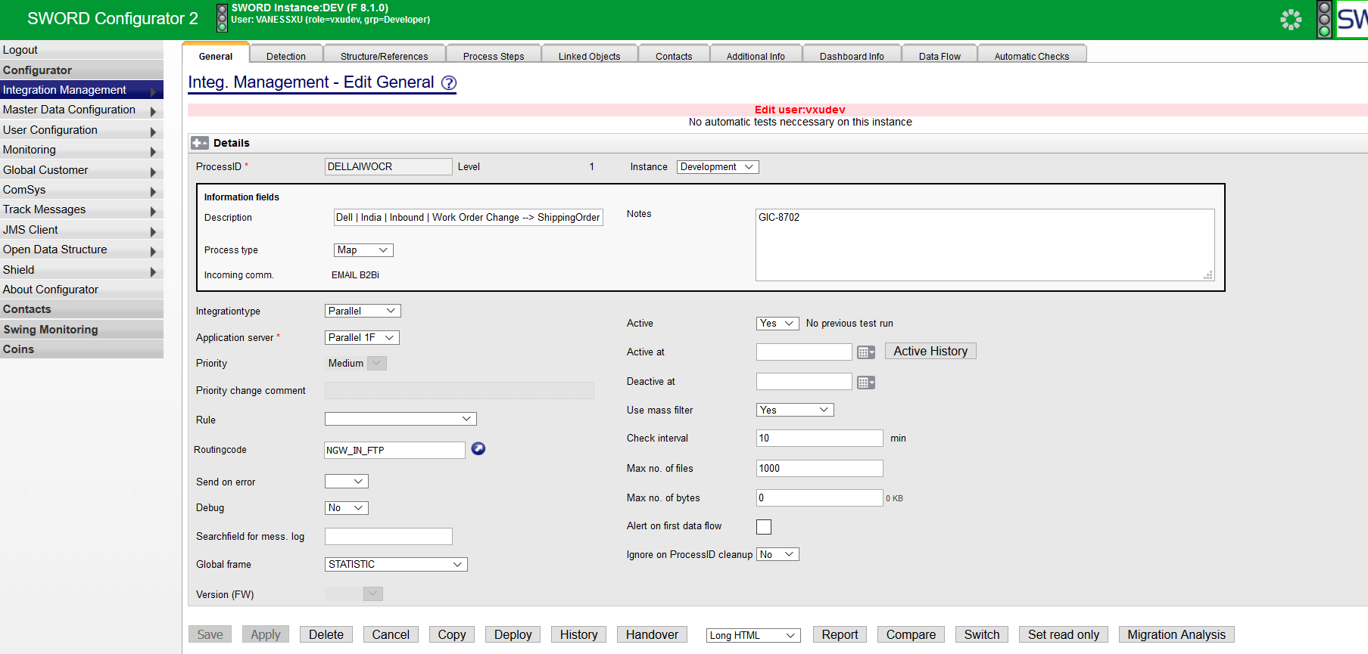
Process Development
General Info

Slide 8
Process Development
General Info
 | Description | Default Value
Level | For version control and roll-back, changes done on a new level
Active / Debug | Yes or No | No
Information fields | Description: copy from customer document chapter 2 overview routing Description Process type: Mapping/Routing
Integrationtype | Manage the dataflow in XIB: Parallel/Serial/Serial large/… From customer document chapter 7 Process Type | Parallel
Application Server | Parallel 1A: MQ(AQ.CUST1) Parallel 1B: use rule SCXXEALLXX, SGI_RULE Parallel 1C: OFTP2 Parallel 1D Parallel 1E Parallel 1F: default for new integration without dependency Parallel 2A: VIP
Priority | Manage the priority of data flow: High/Medium/Low | Medium
Rule | Used for content detection for a process
Routingcode | Info about where to send data and what connection to use
Global Frame | Fixed steps of MBCs to use in Process Steps, marked orange | STATISTIC
Use Mass Filter | Define maximum number of files and size of file to receive | Yes

Slide 9
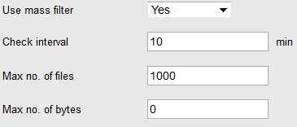
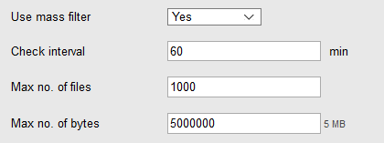
Process Development
General Info
  Settings for Mass Filter:
  APAC
  Others

Slide 10
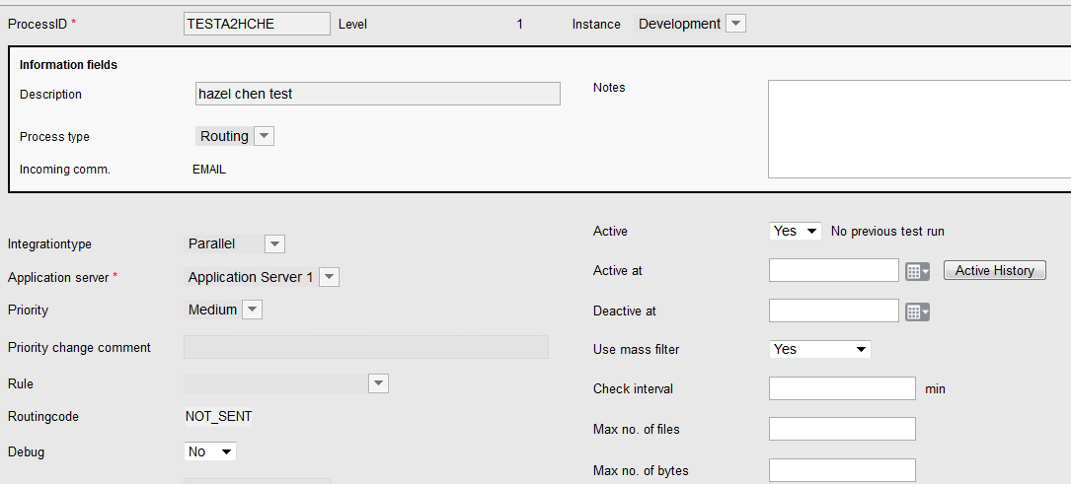
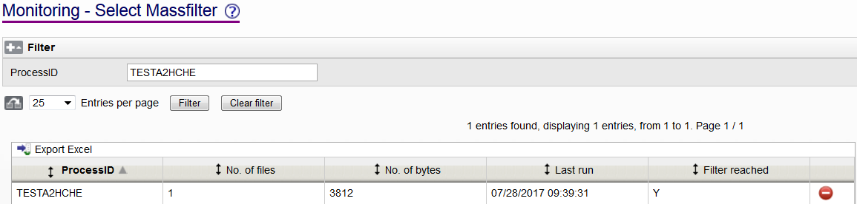
Process Development
Mass Filter

Slide 11
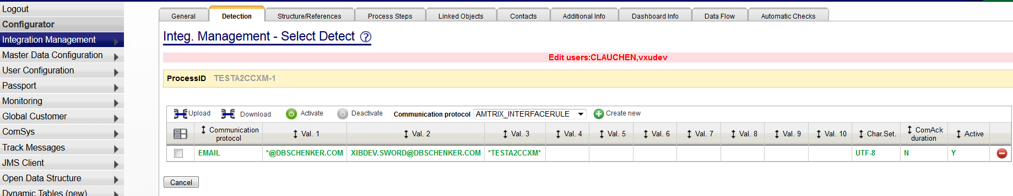
Process Development
Detection
  For assigning a message to a process (AS2, EMAIL, Comsys, Rule…)

Slide 12
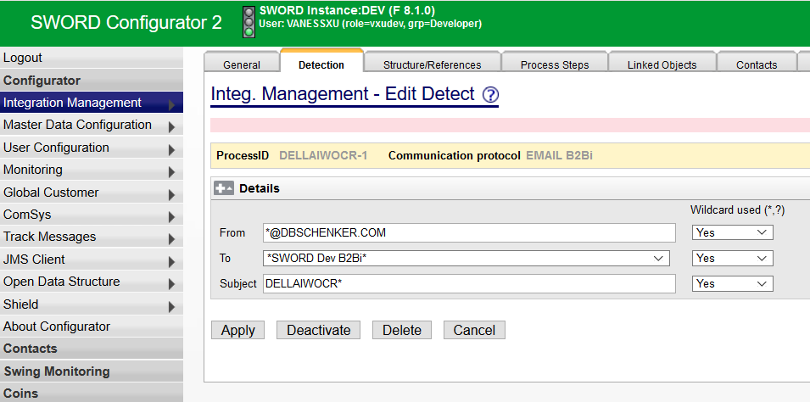
Process Development
Detection
  Create a New Detection – EMAIL B2Bi

Slide 13
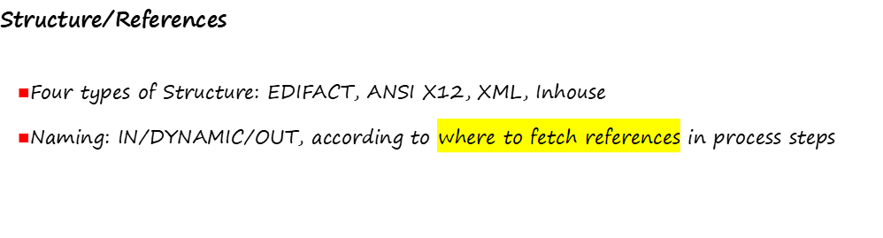
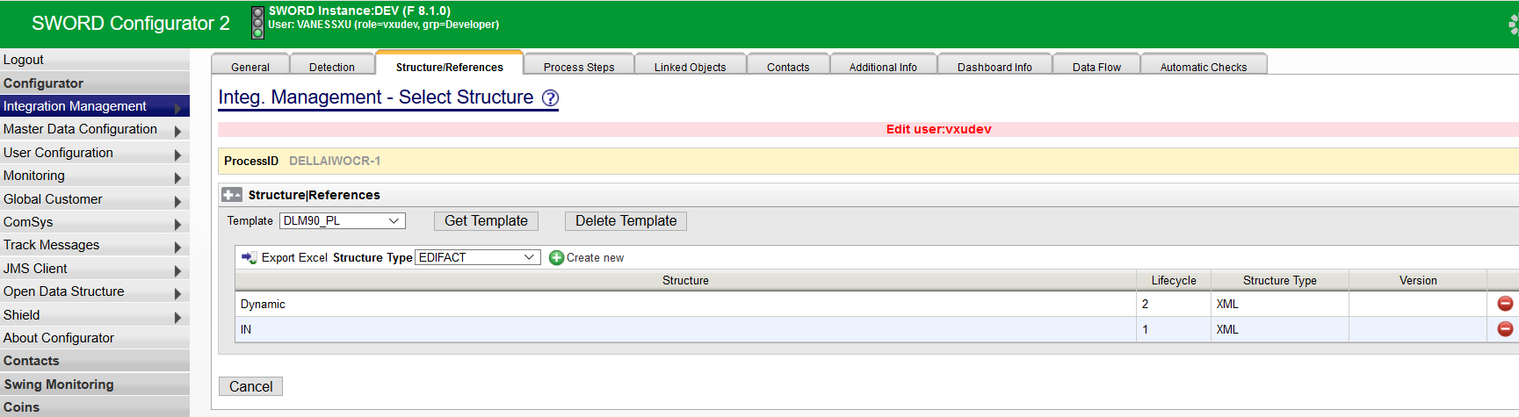
Process Development

Slide 14
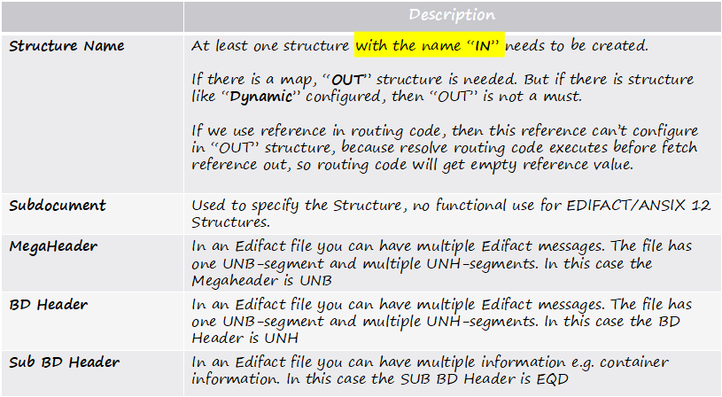
Process Development
Structure

Slide 15
Process Development
Reference
 | Description
Name | Name of the reference e.g. AWB-NO, Message type, sender, Receiver etc.
SEQ # | There is a possibility to look for 10 references in SWING, therefore SEQ# 1 to SEQ# 10 are for searching in SWING. All other SEQ # have only information function, no searching function.
Part # | In most cases the part of the Sequence is 1, but sometimes you need to join fields e.g. CIS-1234444 CIS is a Constant Value SEQ 1, Part 1 1234444 is a segment from the message (e.g. BGM) and SEQ 1, Part 2
Constant Value | Constant value, independently from the message context
Record ID | Record ID from that the reference is to be pulled
Concatenating Function
Concatenating Character | When two parts must be joined you can define a Concatenating character e.g. / , - etc.
Start Pos. or Group | Start of the position of the reference
End Pos. or Field | End of the position of the reference
Qualifier Start or Group | Start position of the qualifier RFF+BN+12345 RFF is the record ID, BN is the qualifier
End or Field | End position of the qualifier
Value 1/2 | Value of the qualifier e.g. BN

Slide 16
Process Development
Reference
 | Description
Start Subposition | If you would like to have only a part of the reference, you can declare the start position of the part e.g. BGM+987651 and only 7651 shall be used Start position is 3
End Subposition | If you would like to have only a part of the reference, you can declare the end position of the part e.g. BGM+987651 and only 7651 shall be used Start position is 6
Message specific values | The system can store some message specific values like Original filename Original filename without extension Running number BD Running number SUB BD Date Email Subject
String function | String functions are Trim Trim Left Trim Right Trim 0 Trim 0 Left Trim 0 Right Uppercase Lowercase Replace # by _
Shared Services Center

Slide 17
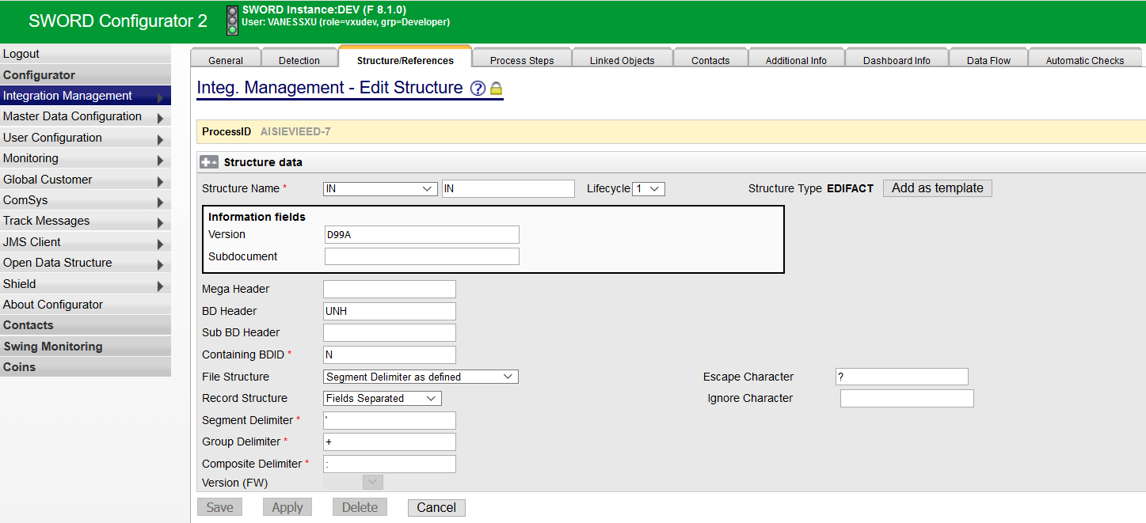
Process Development
Structure/References
  Structure Type: EDIFACT

Slide 18
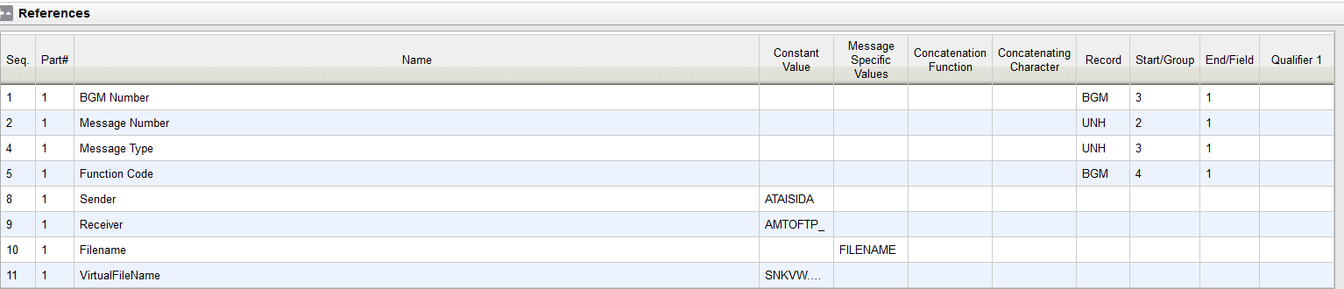
Process Development
Structure/References
  References: EDIFACT

Slide 19
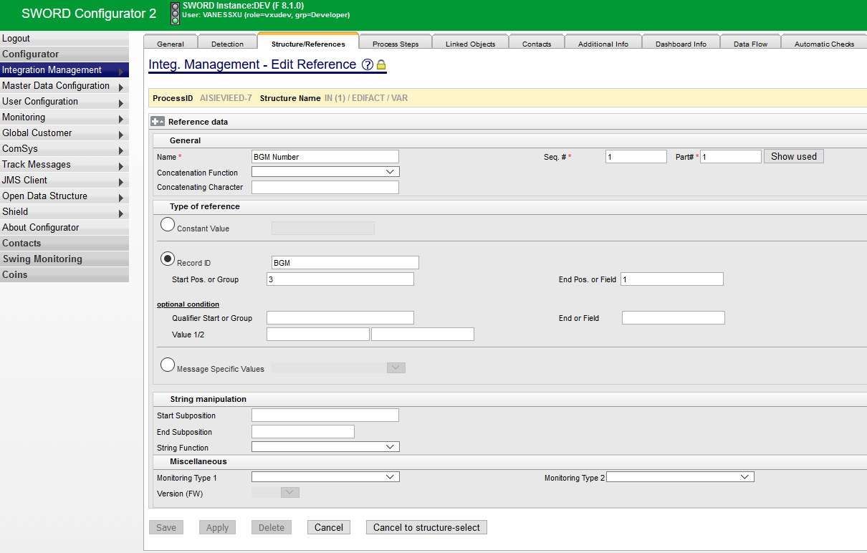
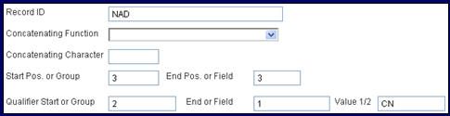
Process Development
UNH+IFTMIN:1123’
BGM+740+2’
REF+ORD:123-23’
NAD+CN+ALFREDSTR:81:ESSEN’
NAD+CZ+RÜTTENSCHEIDERSTR:96:COLOGNE’
UNT+7+1123’
Structure/References
  Fetch Reference 1 – dynamic value
Record-ID = NAD Group = 3, Field = 3
Qualifier “CN” in: Group = 2, Field = 1
Record-ID = BGM Group = 3, Field = 1

Slide 20
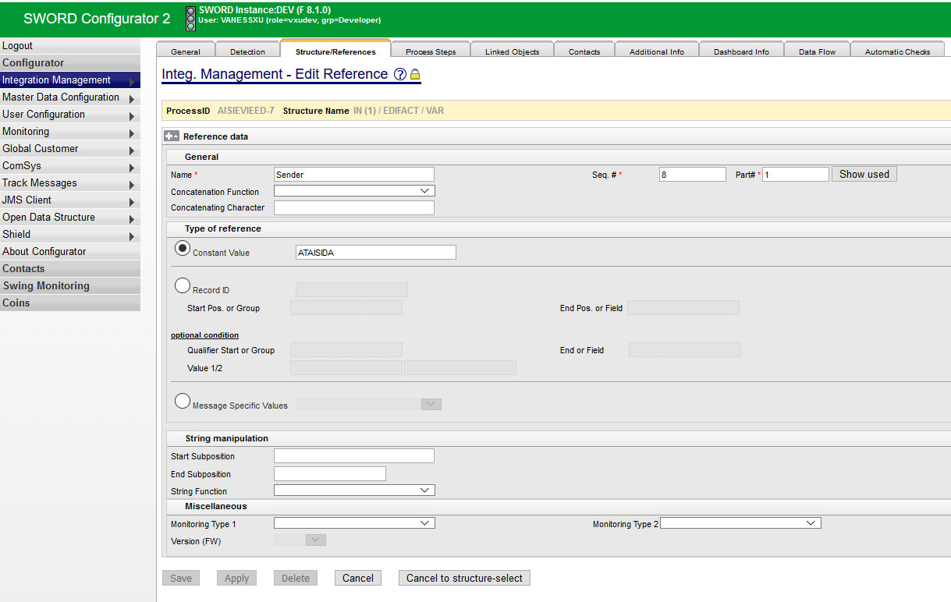
Process Development
Structure/References
  Fetch Reference 8 – constant value
Constant Value:
Can also use bracket code
e.g: <PROCID>

Slide 21
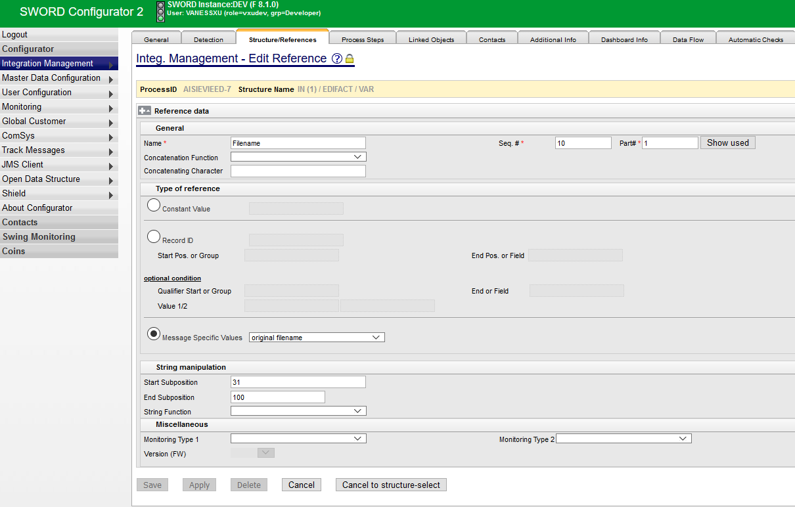
Process Development
Structure/References
  Edit Reference 10 – original filename (defined for internal use, e.g. support)

Slide 22
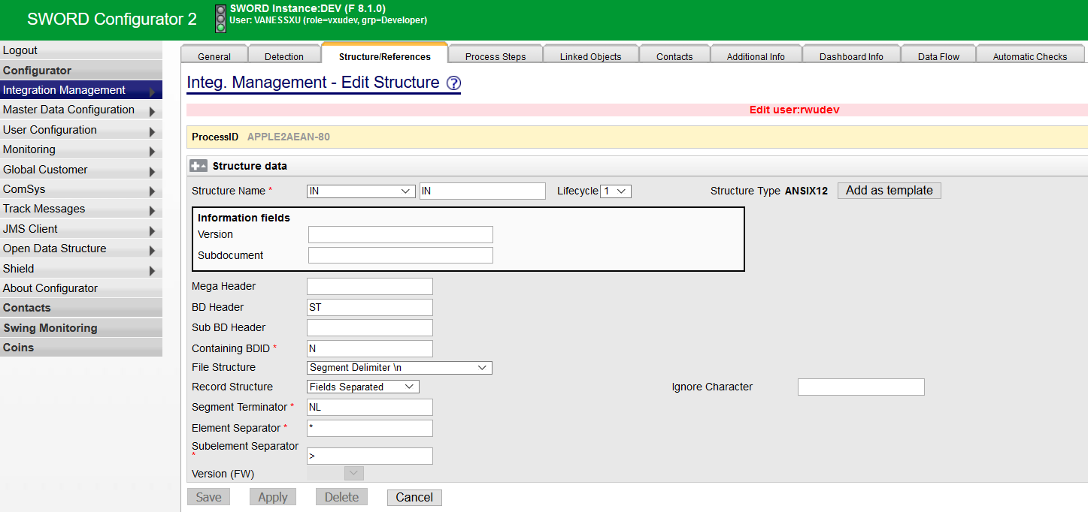

Process Development
Structure/References
  Structure Type: ANSI X12
Select this option when:
EDIFACT file with UNA
ANSI X12(for X12 it’s better to choose this option, it’s prior to below settings)

Slide 23
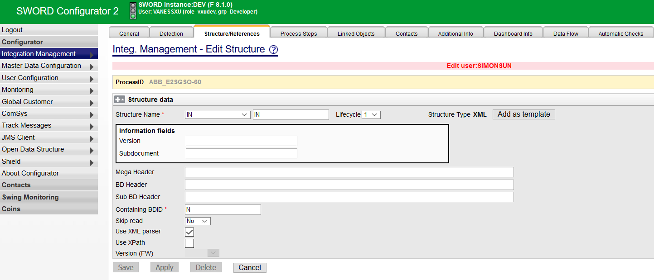
Process Development
Structure/References
  Structure Type: XML

Slide 24
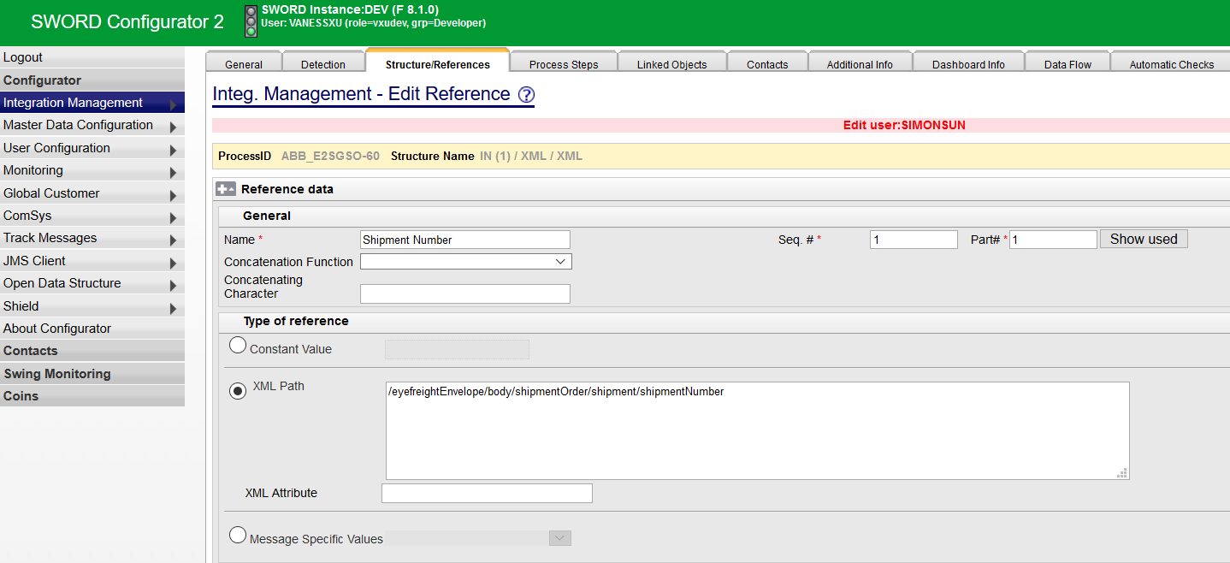
Process Development
Structure/References
  Fetch Reference 1- based on XML Path

Slide 25
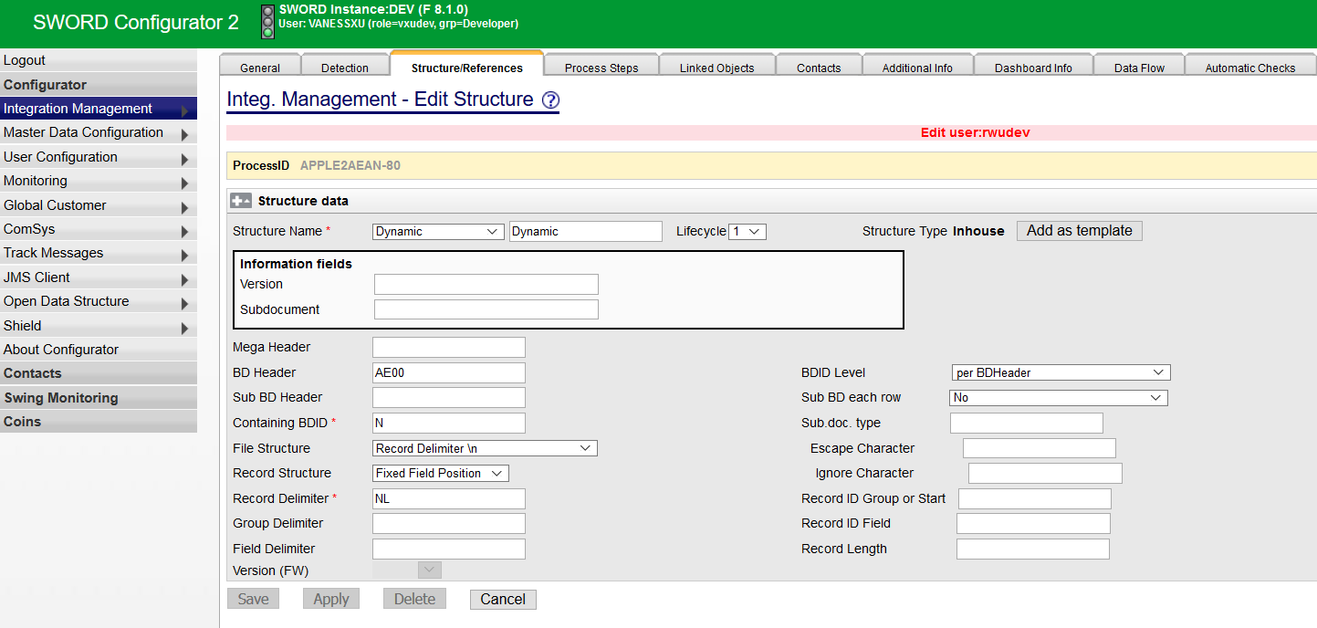
Process Development
Structure/References
  Structure Type: Inhouse – fixed field position (e.g. AE)

Slide 26
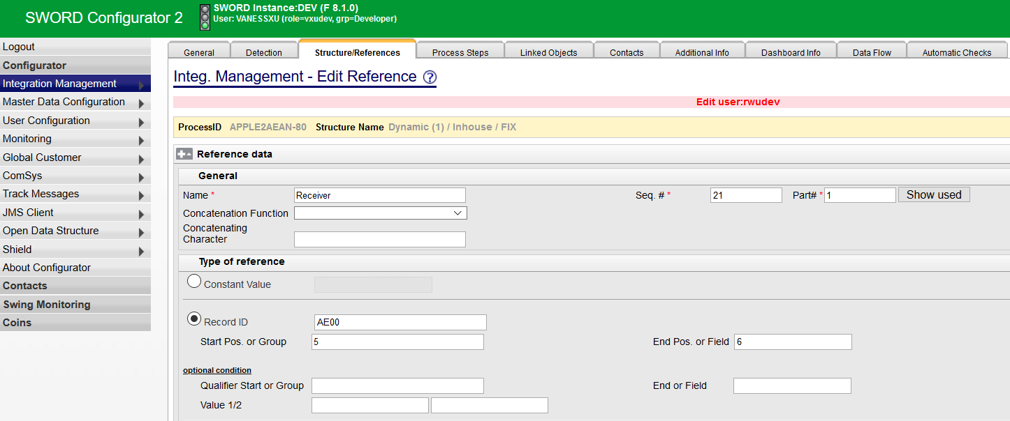
Process Development
Position: 12 34 56 78 9 …
Structure/References
  Fetch Reference 21 – based on fixed position
AE00SE1010 000 20110107081720 GEN AE10610 9 20110107 AE30XRFDON:0087104169
...

Slide 27
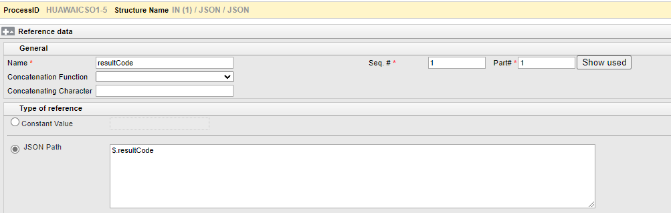
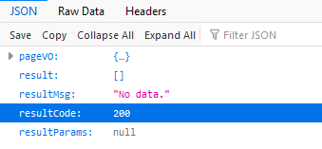

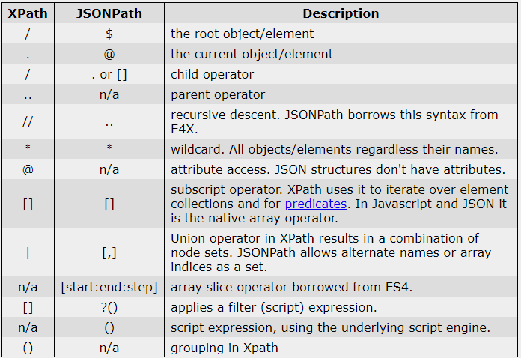
JSON
Reference Page:
JSONPath - XPath for JSON (goessner.net)
http://jsonpath.com/
Schenker China Ltd.

Slide 28
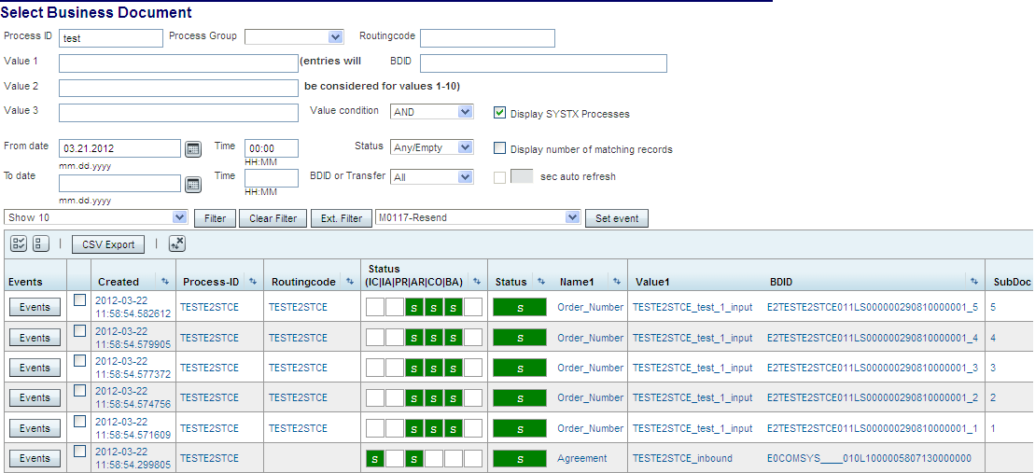
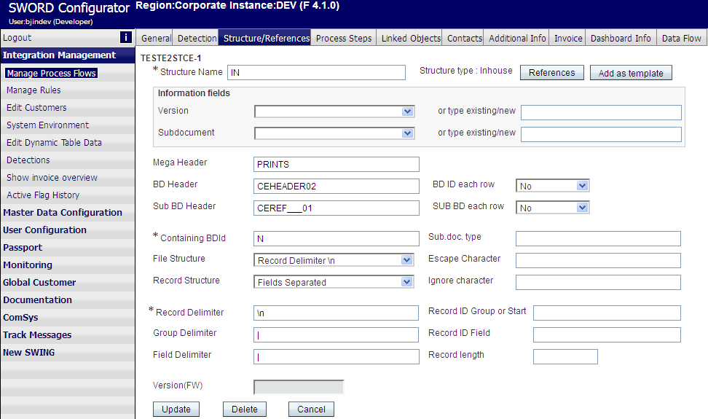
Process Development
Structure/References
  Structure Type: Inhouse – fields separated by delimiter (e.g. CE)
one BDID for one Business Document
one sub BDID for
one Subdocument

Slide 29
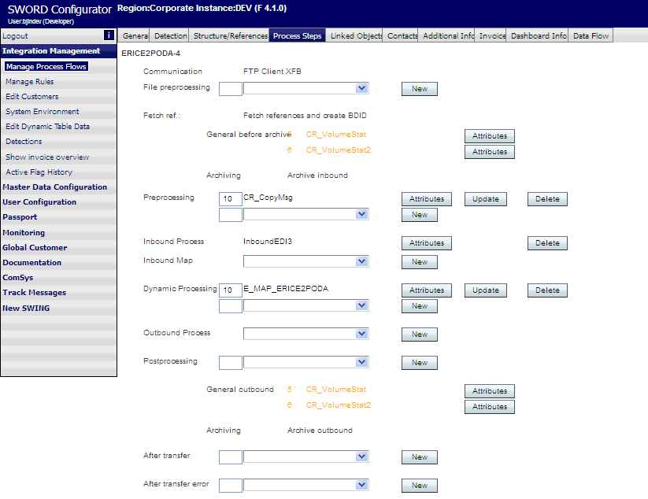
Process Development
Process Steps
Detection
Inbound
Dynamic
Outbound
After Transfer

Slide 30
Process Steps
Stage | Purpose
File preprocessing | Make a file readable for the framework (e.g. unzip). If files are changed in this stage, please add CR_StoreMessageToDisk as first MBC, to archive the raw data. File preprocessing won´t be executed if files come in via rule.
PreProcessing | Manipulate a file for the Inbound stage
Inbound | Select MBCs to split a file into messages, e.g. InboundEDI3, InboundX12
Dynamic | Main stage for transforming files
Outbound | Enveloping / merging of messages into files, e.g. EnvelopeEDI3, EnvelopeX12
PostProcessing | Transform a file, that has been enveloped

Slide 31
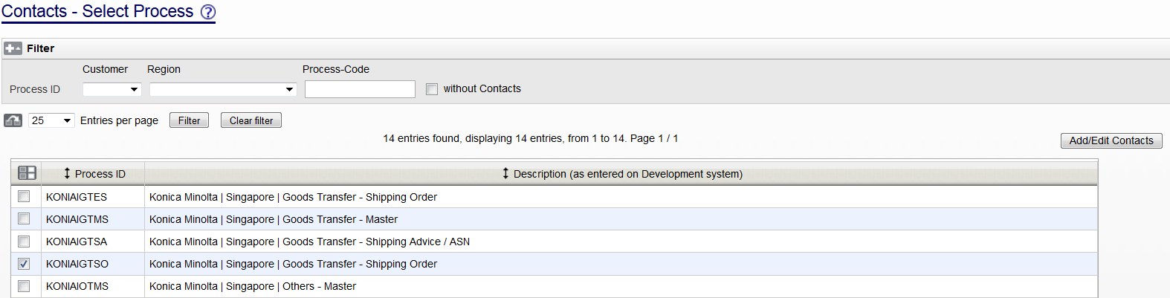
Process Development
Contacts
Shared Services Center

Slide 32
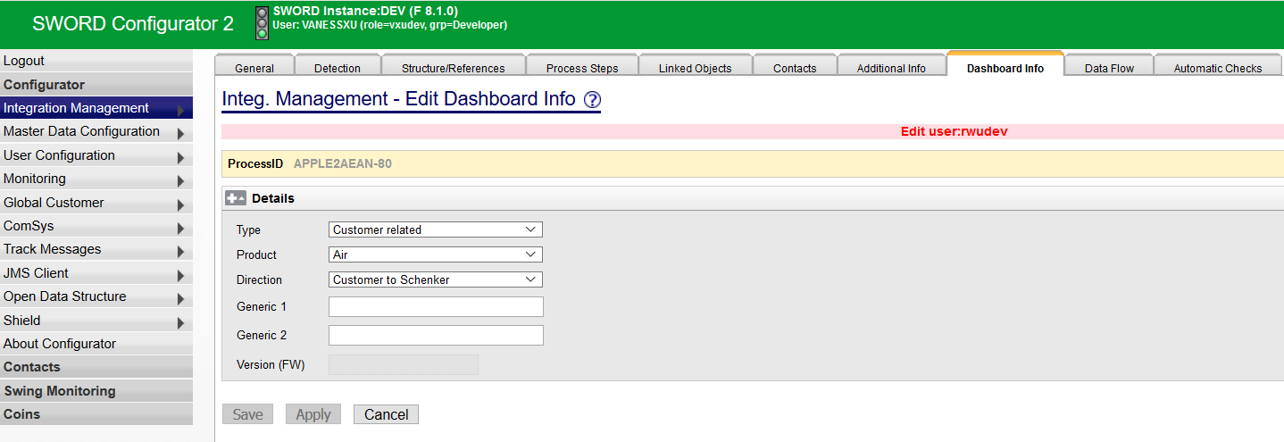
Process Development
Dashboard Info
Shared Services Center

